Slide 1
LinkedIn for Job Seekers
Notes:
Thanks for taking the time today to listen to the benefits that LinkedIn can provide to those seeking a job. Today, we'll discuss some great tools that can help in your career development including tools to help you find post-bachelor’s degree opportunities, research peers, and discover business connections.
Be sure to always check the LinkedIn blog for exciting news announcements about the site. Social networks are always changing, and being on the forefront can lead to new opportunities. If you have any additional questions about getting the most out of LinkedIn, please contact me or your Putnam internal wholesalers.

Slide 2
The world’s largest professional network
562 million
users across 200 countries
87% of recruiters
use LinkedIn at some point in the hiring process
Over 57 million
companies sharing data
65 million
users in decision-making positions
Source: LinkedIn, 2022.
Notes:
These stats show why professionals need to be on LinkedIn.
If you don't utilize this platform, you could miss out on important opportunities in the future.

Slide 3
LinkedIn provides tools for every step of your professional development
Brand yourself: Optimize your profile and post thoughtful content
Find opportunities: Research with Company pages
Build your network: Connect and engage with former colleagues, alumni, and other professional contacts
Get a job: Discover opportunities on the jobs page
Notes:
It's important to start creating your digital footprint. Today we will cover ways LinkedIn can help you, including:
Brand yourself online
Build your professional network, and
Land your first job
Use the information available to you to research potential colleges and universities, get an internship, or look for a job.

Slide 4
Brand yourself

Slide 5
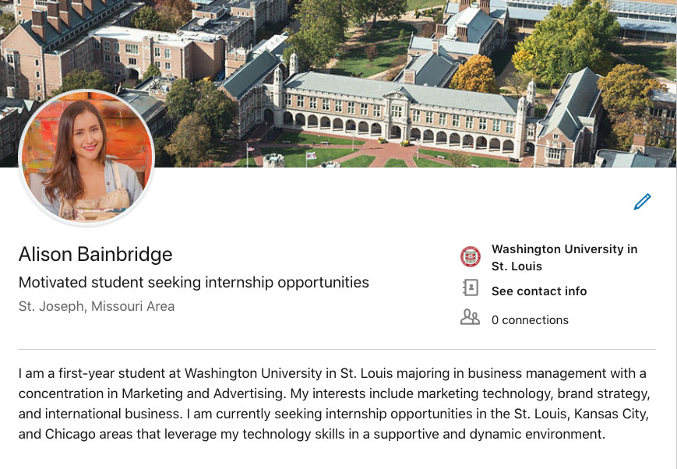
Getting started: Optimize your LinkedIn Profile
PROFILE PICTURE
1
PRO TIP:
Your photo is the most remembered item on your profile.
3
EDUCATION
HEADLINE AND LOCATION
2
SUMMARY
4
CUSTOM URL
5
Notes:
An important first step for making the most of LinkedIn — Optimize your profile.
Doing this correctly can make your profile more attractive to search engines — meaning it will be much easier for people to find you when conducting an online search. You also want to bring your profile in line with professional best practices.
One item to focus on is your profile picture. Pictures speak louder than words. Choose an image that shows you in a professional setting, dressed appropriately. A professional headshot is best. Choose neutral, rather than bright colors. Not recommended: “Selfies” taken with your phone, or pictures in a casual setting.

Slide 6
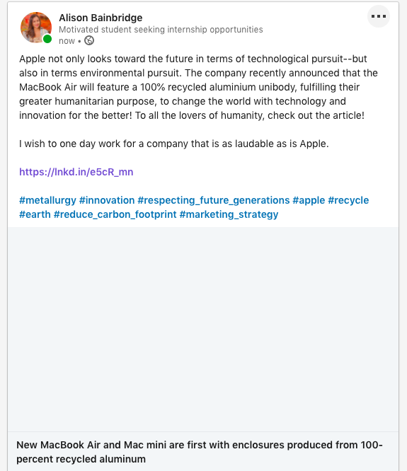
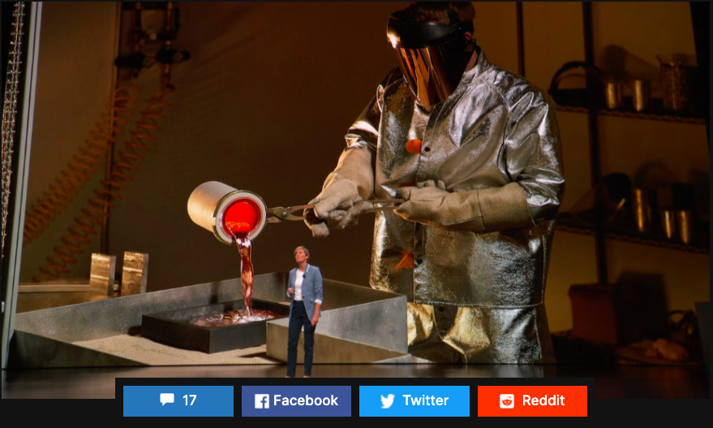
Establish your voice to get noticed
Carefully choose subjects for which you’d like to be known
Start regularly sharing interesting content related to these topics
Ask for profile recommendations and endorsements from mentors
Notes:
You must also establish your voice to get noticed on LinkedIn.
Carefully choose subjects for which you’d like to be known, start regularly sharing interesting content related to these topics, and ask for profile recommendations and endorsements from mentors.

Slide 7
Find opportunities

Slide 8
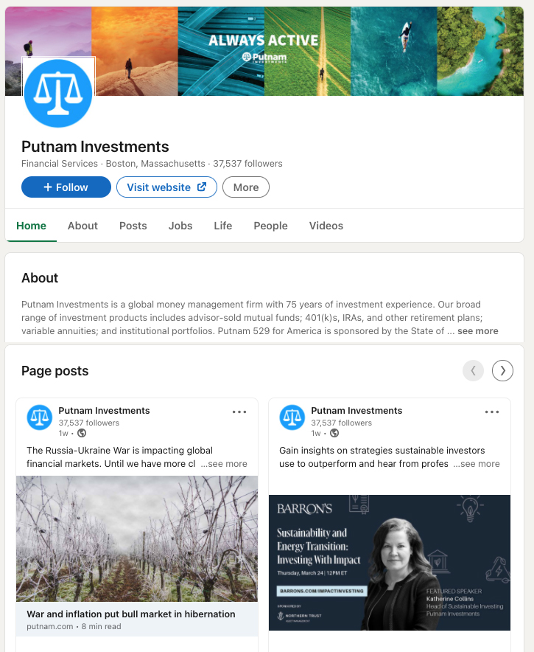
Gather intel from Company Pages
Learn about the company and its business
See current job postings
Identify who you may already know
JOB POSTINGS
EMPLOYEES
COMPANY CONTENT AND CULTURE
Notes:
Gathering intel from company pages can help you be more successful in networking. On the pages you can, learn about the company and its business, see current job postings, and identify who you may already know. Follow the company using the blue button to receive notifications about them right on your LinkedIn homepage.

Slide 9
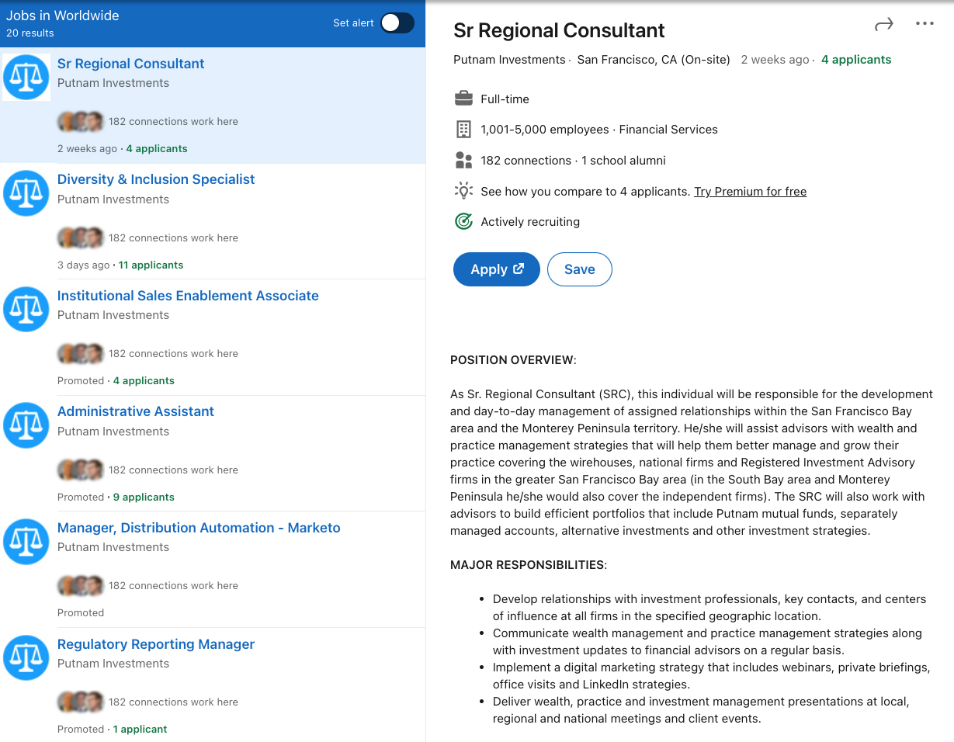
Career Insights tool
FILTER BY DATE POSTED OR EXPERIENCE LEVEL
Review current job postings
Connect with employees who may offer an introduction
GROW YOUR NETWORK BY CONNECTING WITH MORE COMPANY CONTACTS
REVIEW KEYWORDS IN JOB DESCRIPTION
Notes:
The Career Insights tool lets you filter alumni data from each university you select. You can search through alumni by the year they graduated, you can narrow your results by searching for a title, keyword or company, and you can identify the best alumni to connect with to help you accomplish your career goals.
This section is meant to help you determine how to break into your field of choice and suggest people to connect with that can help you on your journey.

Slide 10
Build your network

Slide 11
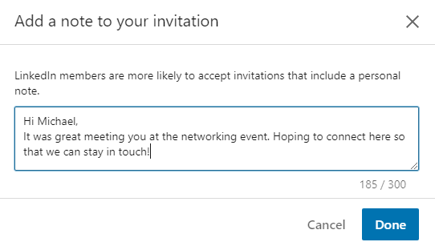
Make quality connections
Connect with people you already know
Colleagues
Alumni
Recruiters
Friends and family
Personalize and provide context
PRO TIP:
Make quality connections. The higher the quality of your network, the higher the quality of the opportunities you’ll uncover.
Notes:
Start to build your LinkedIn network by searching for people you already know. Chances are they’re already on LinkedIn.
Build your network around people you know and who will know you when you request to connect.
Specifically, connect with your friends' parents AND your parents' friends. Many people who start at Putnam have leveraged the referral networks of current employees. One of the best places to look for an internship or job is through your parents' network.
The value of your LinkedIn network is only as rich as the connections you make.
Use LinkedIn’s “People you may know” feature to regularly build your network.
Make this a standard part of your LinkedIn practice, and check it at least once a week.

Slide 12
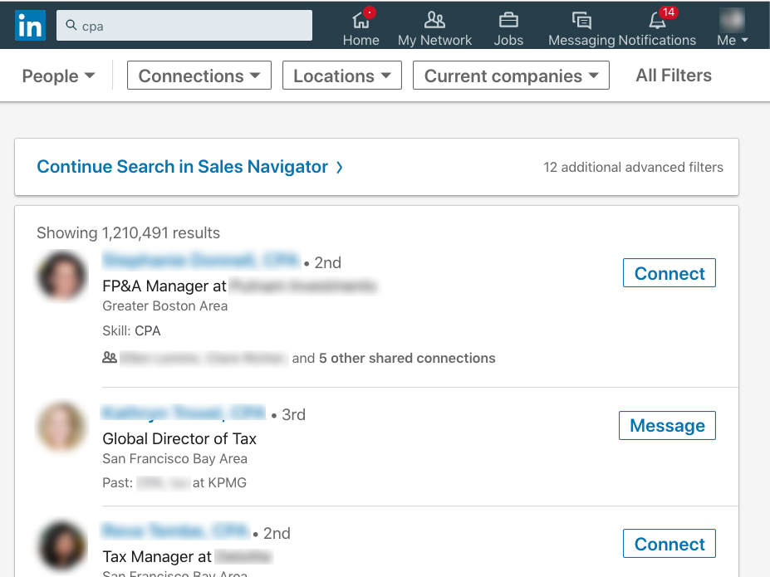
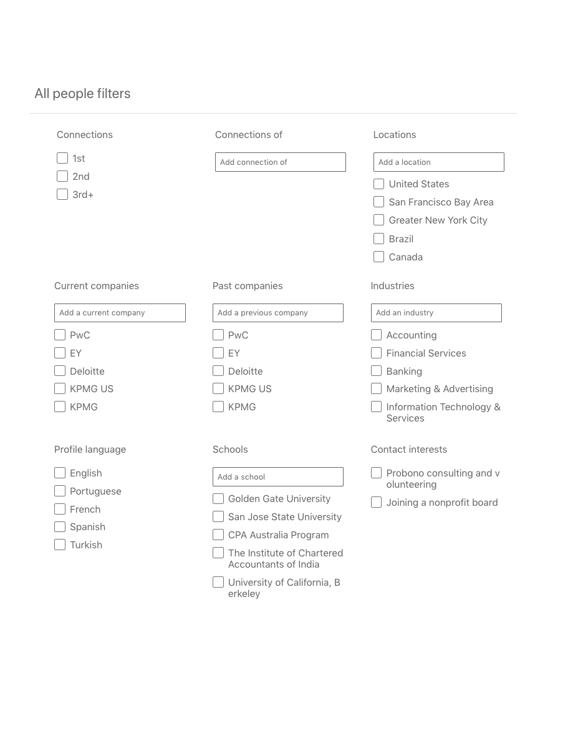
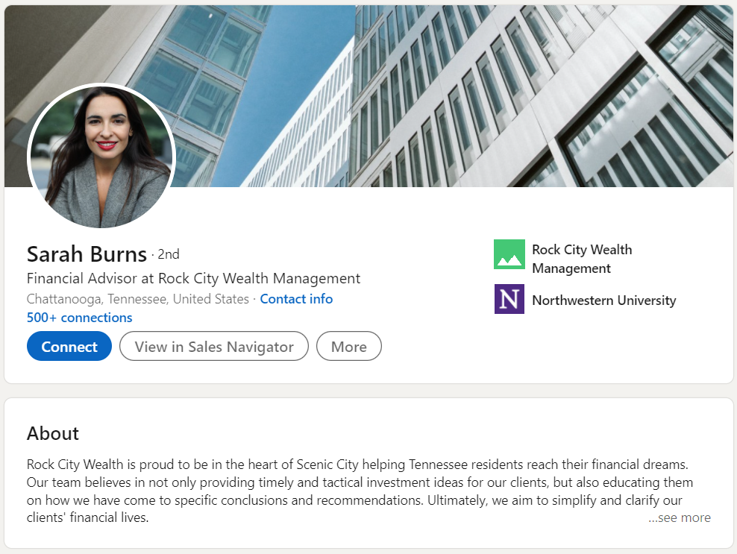
Expand your network through mutual connections
Review current connections of contacts you know well
Narrow down the search using All Filters for targeted introductions
Notes:
Also consider expanding your network through mutual connections. Begin on a connection’s profile and select their number of connections. Then, using the search filters, narrow down to an individual in your industry that you may want to be introduced to.

Slide 13
Get a job

Slide 14
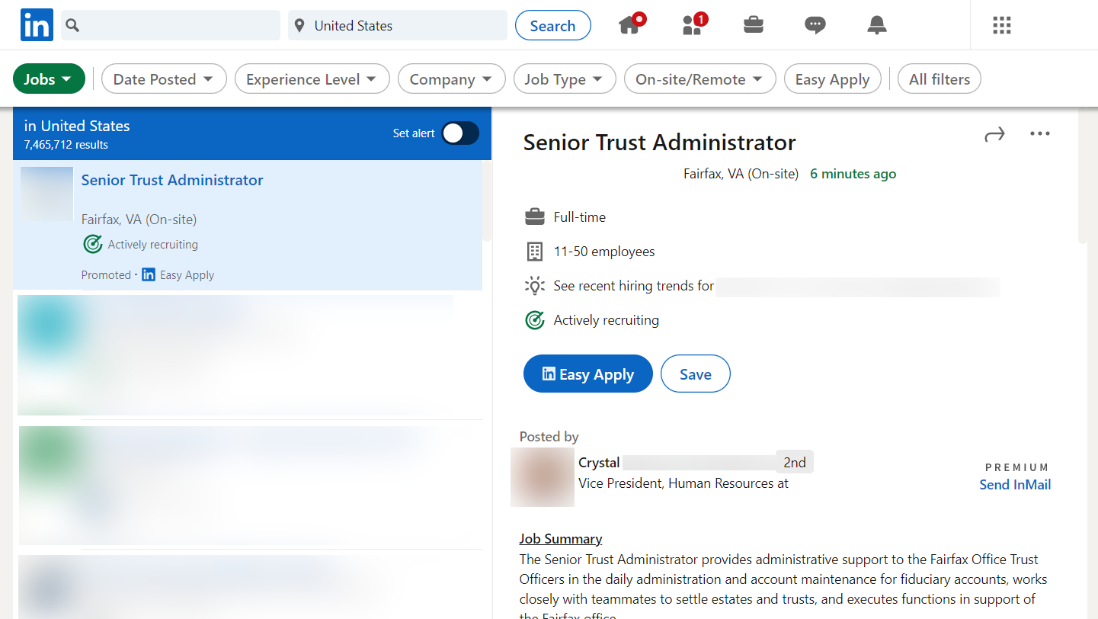
Search jobs
FILTERS LET YOU SEARCH BY DATE, COMPANY, AND EXPERIENCE
Click the briefcase icon on the top toolbar
Quickly search for entry-level jobs and internships
NARROW YOUR SEARCH TO GET THE BEST RESULTS
Notes:
The job search feature lets you focus results with a few important filters:
Date posted: brings up the newest posts first
LinkedIn features: lets you search for jobs connected people in your network, pulls in jobs that have under 10 applicants, and lets you narrow your results to only jobs that accept "LinkedIn easy apply"
The other filters are pretty self explanatory, but the key is to use these tools to find the jobs that are most relevant to your experience and career goals.

Slide 15
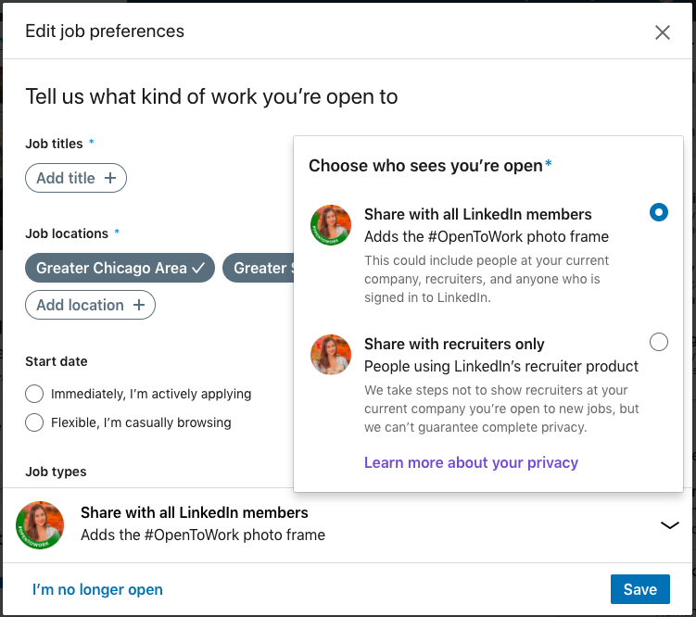
Edit job preferences
ACTIVATE EITHER FEATURE SO RECRUITERS KNOW THEY CAN MESSAGE YOU ABOUT RELEVANT OPPORTUNITIES
Let recruiters know if you’re open to new opportunities
Select the titles of jobs you’re interested in
Define a location
Choose some industries
Determine the right company size
Notes:
If you're looking for a new job or internship, be sure to turn on the "Let recruiters know you're open" to new opportunities button. This lets them know it's OK to message you about open positions.
When you flip this switch, it's important to also fill out your career interests so recruiters can reach out with the most relevant positions. You can tell them:
Where you are in your search
When you can start
Which titles are most appealing to you
Which locations you're considering
What type of job fits you best (full/part-time, internship)
Which industries you're focusing on
What size company fits you best
The more complete this section is, the more relevant your discussions (and the positions) will be.

Slide 16
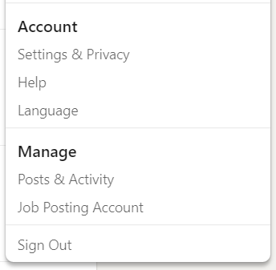
Privacy settings
Notes:
LinkedIn offers numerous privacy settings.
One thing to remember: The more anonymous you make yourself, the more difficult it will be for prospects to find you.
Let’s concentrate on three major settings I’d like you to consider:
Adjust “Edit your public profile” to choose how your profile appears in search engines.
Adjust “Who can see your email address”
Adjust “Who can see your connections” and “Viewers of this profile also viewed” — you could be giving free advertising to your competitors!
Note: Activity Broadcasts can now be selected at the time when you’re updating your profile (example: profile picture or summary change).

Slide 17
Closing thoughts: Getting started
Optimize your LinkedIn profile
Start to make valuable connections
Ask for targeted recommendations and endorsements
Use the search tool for research on companies and jobs
Switch your profile to “open to” if you’re actively searching for jobs
Continually enhance your social brand
Notes:
Thank you for your time today!
In closing, LinkedIn can help you to progress your career by helping you to,
Brand yourself online
Build your professional network, and
Land your first job
Continue to enhance your social brand with the key ideas we shared today. If you have any questions, please let us know!

Slide 18
This content is offered for informational purposes only and is not meant as an endorsement of any particular application, mobile device, or social networking site.

