Slide 1
Growing your business with social media

Slide 2
If you operate in a regulated industry, become familiar with the rules governing social media for your company. This presentation is for educational/illustrative purposes only and is not an endorsement of any website or any social media networking services mentioned herein.
Notes:
This presentation is for information purposes only. If you operate in a regulated industry, become familiar with the rules governing social media for your company.
Stay compliant with any regulations or guidelines, how ever they are defined.

Slide 3
Why LinkedIn? The numbers tell a story
185 million
U.S. users
Companies with a complete, active LinkedIn Page see 5x more page views
58 million
companies have a page on the platform
Source: LinkedIn, 2022.
Notes:
As of 2022, LinkedIn has 185 million users in the United States.
58 million companies globally have a page on LinkedIn.
Analysis by LinkedIn shows that companies with a complete, active LinkedIn Company Page see 5X more page views.

Slide 4
Agenda
Your business on social media
Your personal brand
Growing your business with LinkedIn

Slide 5
Your business on social media
Notes:
Once you’ve taken care of yourself, it’s time to establish your business on social media. First, set up a “Facebook for business” page, where you can tailor content and messages specific to your work and professional relationships.
It is no longer simply a “good idea” for businesses to be on Facebook. With 829 million people actively using it every day, Facebook is a critical component of almost any business marketing strategy.

Slide 6
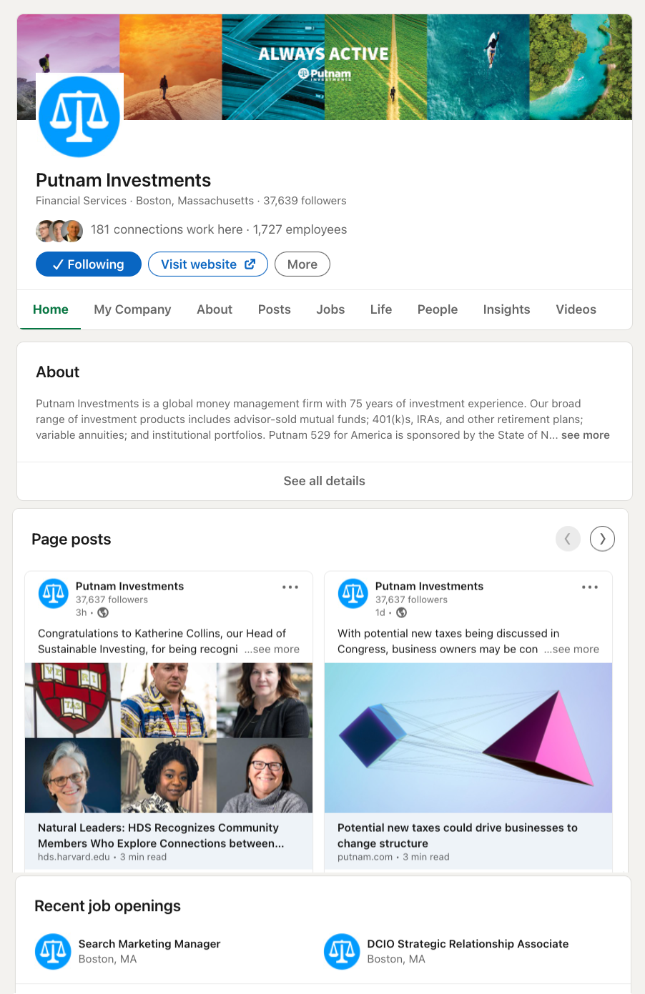
Build your Company Page
BRANDING: LOGO AND COVER PHOTO
1
4
EMPLOYEES
2
COMPANY STORY
5
COMPANY UPDATES
JOB POSTINGS
3
Notes:
Next, set up a LinkedIn company page — this is the home for your business on LinkedIn.
The Overview section is where you brand your business. For an image, choose an eye-catching image that exemplifies your company culture or your business focus.
Use LinkedIn for job postings. LinkedIn is revolutionizing the HR industry, and is now considered the most cost-effective way of finding new employees.
Make sure your employees have positioned and labeled your business correctly in their profiles. Members viewing your company page will see how they’re connected to your business.
Set up a Showcase Page to highlight a particular product or subset of your business.
Post regular company updates. LinkedIn members who follow your company will receive these items in their news feeds.
The number of people following your business will grow organically if you build a good page, if your employees indicate your company in their profiles, and if you post regular network updates.

Slide 7
Create affiliate pages
Dedicate separate pages to different aspects of your business
Highlight special initiatives
Showcase important business units or brands
Gather unique groups of followers
https://www.linkedin.com/pulse/linkedin-company-page-affiliate-showcase-mic-adam/

Slide 8
Build a loyal, engaged community
Post content regularly
Engage with your audience
Leverage LinkedIn Sales Navigator to build a network of targeted prospects and stay on top of social signals from your connections
Dedicate time every day
Notes:
LinkedIn is the main social network for business. To leverage it effectively, fill out your profile in its entirety, paying specific attention to the pieces I mentioned on the previous slide. But turning your community into loyal followers takes dedication. Top performers consistently share relevant content, which could include industry articles, company-provided content, charitable and client events, professional advice, and motivational quotes. They also develop a routine for responding to their network’s life events, commenting on and liking posts, and interacting with prospects and clients in their newsfeed.
Another important LinkedIn feature to note is Sales Navigator. The Putnam Social Advisor Survey shows that adopting LinkedIn Sales Navigator can have a very positive impact on driving new business. With Sales Navigator, you can save very specific searches, save leads, save accounts, and put together a feed of only your most relevant contacts to monitor and engage with.
Before using it, make sure Sales Navigator is approved by your compliance department.
I know this was a lot of information, but to help you internalize this better and make this more manageable, we created the LinkedIn 10-Minute Daily Challenge. It helps advisors get the most out of the LinkedIn platform in 10 minutes or less each day. We’ll discuss this more at the end of the presentation.

Slide 9
Your personal brand
Notes:
When reviewing your personal online presence, your LinkedIn profile is a good place to start.
Your LinkedIn profile is often the first result on Google when someone searches for your name.
Clients now typically check out a profile on LinkedIn before doing business, especially in B2B situations.
Like the classic ad said, “If you don’t look good, we don’t look good.” Your LinkedIn profile is a direct reflection of your company’s online brand — don’t overlook it.

Slide 10
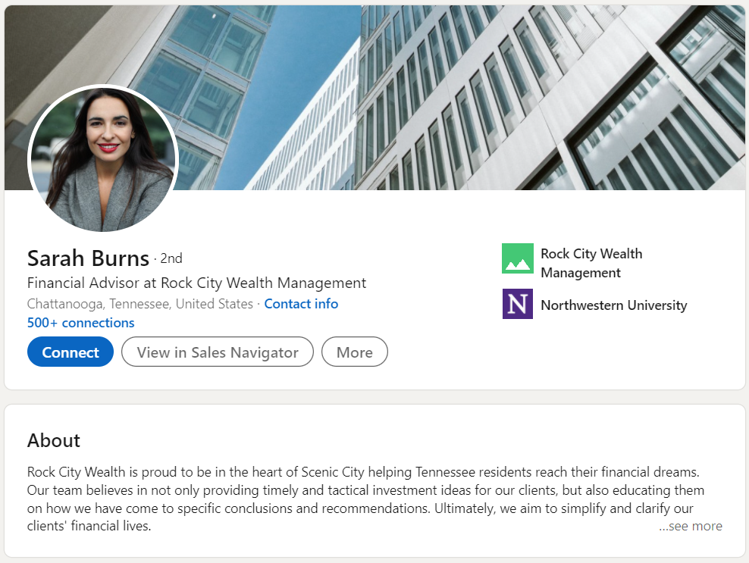
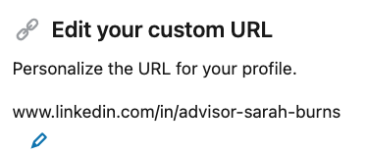
Optimize your LinkedIn Profile
PICTURE
1
PRO TIP:
Your photo is the most remembered item on your profile.
2
PROFESSIONAL NAME
WORK EXPERIENCE AND EDUCATION
HEADLINE
3
4
CUSTOM URL
5
Notes:
Your LinkedIn profile is a compliant extension of your personal brand. An important first step for making the most of LinkedIn — Optimize your profile.
When setting up a LinkedIn profile, you’ll be prompted to fill out the following:
First Name, Last Name
Headline
This can be an attention-grabbing headline about yourself or your current position
Current Position
Education
Country, Zip code
Locations within this area
Will pre-populate with options based on the zip code
Industry
Summary
You can make your profile more attractive to search engines — meaning it will be much easier for people to find you when conducting an online search. You also want to bring your profile in line with professional best practices and firm guidelines.
One item to focus on is your profile picture. Pictures speak louder than words. Choose an image that shows you in a professional setting, dressed appropriately. A professional headshot is best. Choose neutral, rather than bright colors. Not recommended: “Selfies” taken with your phone, or pictures in a casual setting.

Slide 11
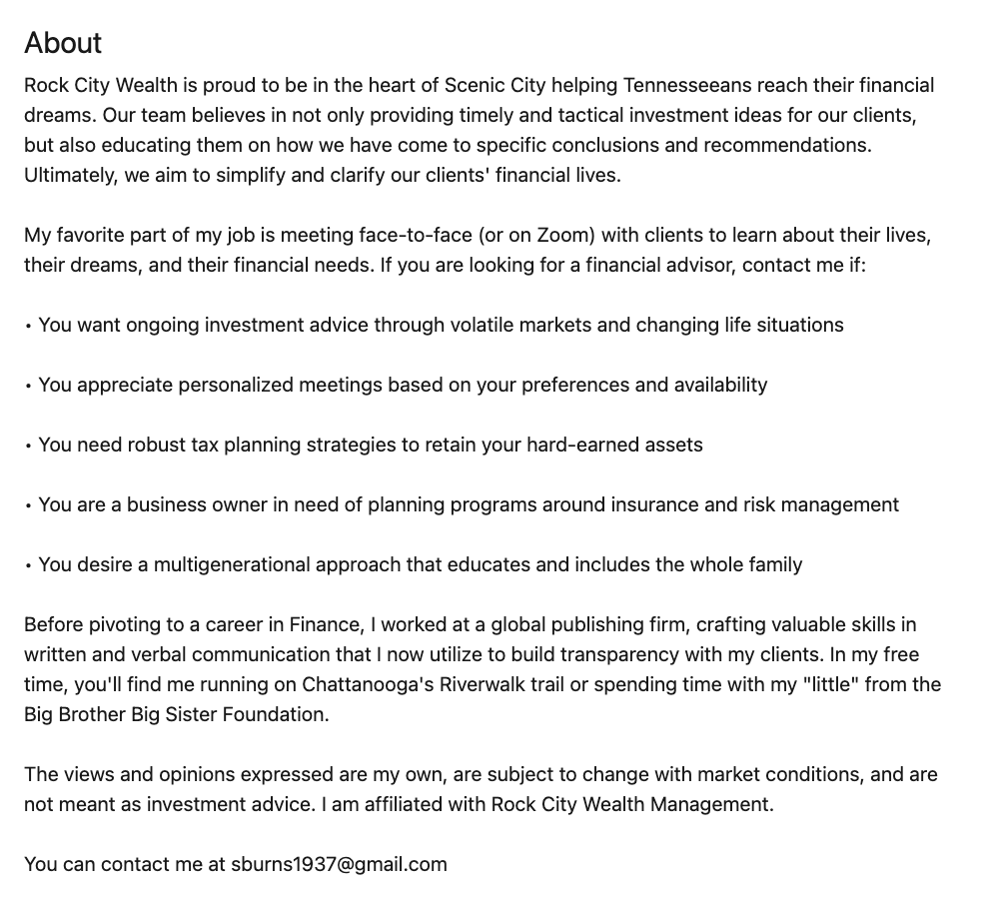
Write a great Summary
FIRST PERSON
1
2
VALUE PROP
PRO TIP: Google places high value on LinkedIn profiles.
Optimizing your profile and including keywords in your Summary places you in a higher Google ranking.
PERSONAL INTERESTS
3
COMPLIANCE DISCLOSURES
4
5
CONTACT INFORMATION

Slide 12
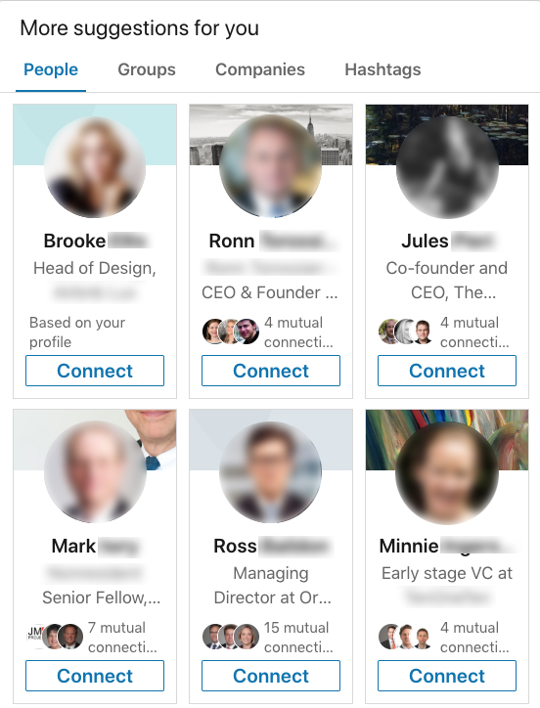
Make quality connections
Connect with people you already know
Your clients
Current team members and past colleagues from other industries (non-FA)
COIs and other professionals like CPAs, attorneys, and tax planners
Professional industry colleagues
Friends and family
Connect with people you may know
PRO TIP:
Make quality connections. The higher the quality of your network, the higher the quality of the prospects you’ll uncover.
Notes:
Start to build your LinkedIn network by searching for people you already know. Chances are they’re already on LinkedIn.
Build your network around people you know and who will know you when you request to connect.
The value of your LinkedIn network is only as rich as the connections you make.
Use LinkedIn’s “People you may know” feature to regularly build your network.
Make this a standard part of your LinkedIn practice, and check it at least once a week.
“Not only are my clients on LinkedIn, but some of my biggest mentors are located here too. It is a more professional site than other social networks.” — Wirehouse advisor, male, 44 years old
“A neighbor heard that I am an advisor and was interested in investing and retirement. He found my business through referencing my name on LinkedIn and contacted me, and we talked immediately. It was quicker through social media than coming to my door one block away.” — Bank advisor, female, age 42

Slide 13
Stay top of mind with your connections
Follow relevant hashtags
Like and Share content
Stay active
Source: Putnam Investments Survey of Financial Advisors’ Use of Social Media (Pulse Edition, 2021), conducted in partnership with NMG Consulting among U.S.-based financial advisors in May 2021.
Notes:
Staying top of mind by posting content is one of the most effective ways to use LinkedIn.
Use pre-approved content supplied to you.
Top advisors use LinkedIn nearly every business day, according to the Putnam Social Advisor Survey (2018).
“In August after I posted an article on LinkedIn, a prospect direct messaged me and we talked back and forth for a few days about where he was financially and where he wanted to be by the time he retired. We set up an appointment within a few days, and he said he felt like he knew me already and was comfortable discussing his goals and risk tolerance right off the bat. I took over as his financial planner and added over $500K to my book of business.” — Female advisor, age 51

Slide 14
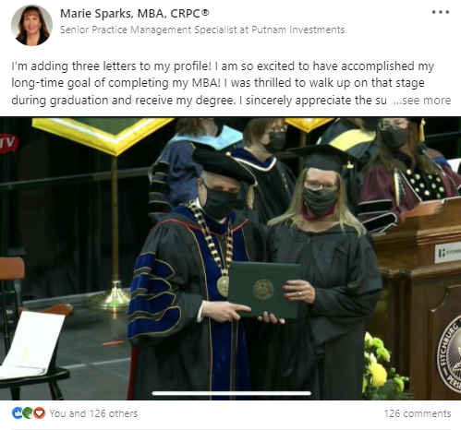
Post content regularly
Develop a routine
Use your home office’s social content library
Balance with timely, personal content
Use relevant hashtags to be part of the conversation
PRO TIP:
Personal content typically gets greater engagement than work-related content.
Consider balancing personal and professional content and gauge your network’s engagement.
Notes:
Regular posting rewards advisors by enhancing search engine optimization, strengthening connection relationships, building brand awareness, and establishing them as industry experts. By investing time in consistently posting using the best ideas shared below, advisors create presence in their absence for clients and prospects.
Make your posts personal and timely
Family and lifetime milestones — share important moments for you and your loved ones
First days of school or graduation
Academic and sports achievements
Birthdays and anniversaries
Births and adoptions
Work milestones — express gratitude for clients and colleagues
Honors and awards
Certifications and designations
Office moves
Welcome a new team member
Congratulate a retiring colleague
Client seminars
Conferences
Local news — subscribe to local periodicals to receive the latest community news
Share commentary on relevant articles
Charity and community events
Seasonality — center updates on cyclical themes and upcoming holidays
Winter — resolutions and reflections
Spring — spring cleaning and tax time
Summer — hobbies and vacation
Fall — back to school and college planning
Create a series — group content by theme to keep consistent
Three financial considerations for retirees
Five financial tips I have learned

Slide 15
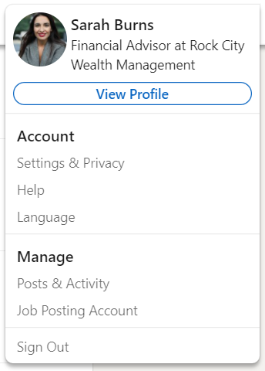
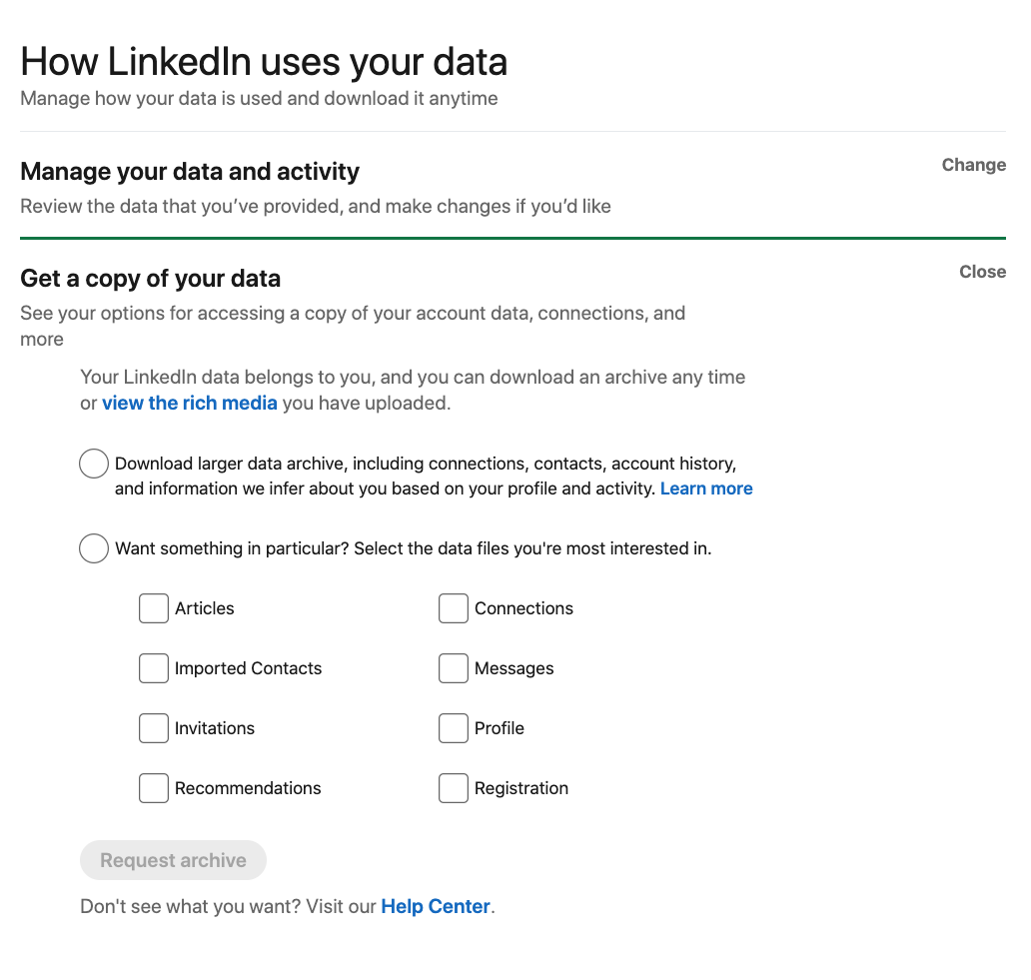
It’s your data!
Notes:
Your LinkedIn data is YOUR data. You can, at any time, request an archive of your data, including a list of your connections.
If you’re using LinkedIn to build a network of prospects, this can be a great way to harvest email addresses for an email campaign or newsletter list.
Under “Me,” go to Settings & Privacy.
Request an archive of your data. We recommend “The Works,” which will give you, among other files, a .csv (comma separated value) file of your Connections. You can then import that data into your email or other marketing system.

Slide 16
Growing your business with LinkedIn
Notes:
One of the most powerful functions of LinkedIn is its ability for you to prospect for "warm" leads across a variety of criteria.

Slide 17
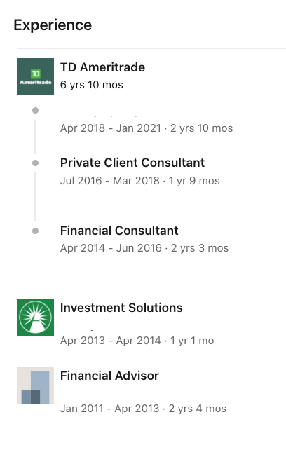
Learn about connections and prospects
Pre-meeting due diligence
One or two degrees of separation
Conversation starters
Notes:
LinkedIn gives you access to information about nearly everyone with a profile.
PRO TIP: Before reaching out to connect with someone, or before a meeting with a prospect, research how you’re connected on LinkedIn. You could know several people in common, participate in the same LinkedIn Groups, have skills and expertise in common, or care about some of the same causes.
These all provide great icebreakers and can dramatically shorten the amount of time it takes to gain the trust and understanding of a potential client.

Slide 18
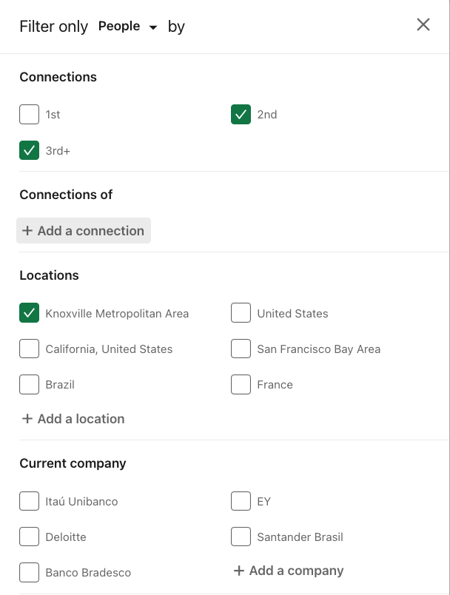
Search your network for new business
PRO TIP:
Begin your search with the search bar in LinkedIn using keywords
Then refine the results using filters.
women executives
#WBE
Accountant
Retired
Senior vice president
20 years of experience
Notes:
You can search your LinkedIn network to find prospects and identify your next, best client. Remember: Your LinkedIn network is greater than your First-level connections; it is the sum of all relationships on LinkedIn to which you are connected, including your connections’ connections, all of your alumni, and common LinkedIn Group members.
Start by entering a broad search term in the search box. In this example, we are looking for CPAs.
The initial search results return nearly 1 million people with “CPA” somewhere in their profile.
To narrow the results, we can apply one or several filters to the results.

Slide 19
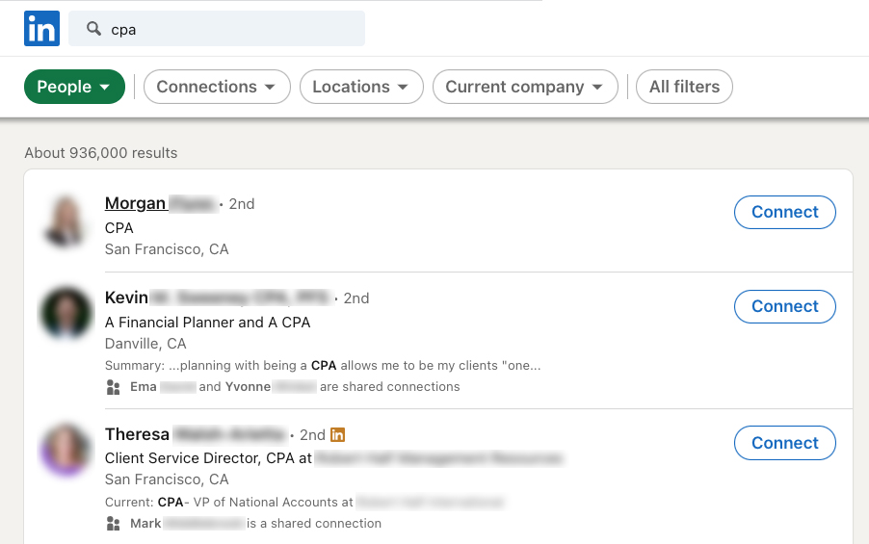
Search your network for new business
Notes:
You can search your LinkedIn network to find prospects and identify your next, best client. Remember: Your LinkedIn network is greater than your First-level connections; it is the sum of all relationships on LinkedIn to which you are connected, including your connections’ connections, all of your alumni, and common LinkedIn Group members.
Start by entering a broad search term in the search box. In this example, we are looking for CPAs.
The initial search results return nearly 1 million people with “CPA” somewhere in their profile.
To narrow the results, we can apply one or several filters to the results.

Slide 20
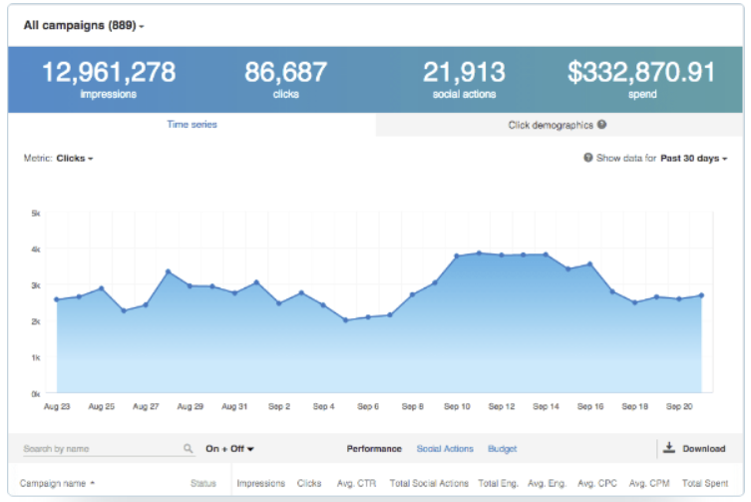
Advertise your business on LinkedIn
Create a free Campaign Manager account
Set a budget, goal, and timeline for your campaign
Select your audience using the targeting tool
Monitor success with tracking and analytics
https://business.linkedin.com/marketing-solutions/how-to-advertise-on-linkedin
Notes:
Alumni are one of the best sources of relevant connections and potential referrals.
To find alumni connections, enter your college, grad school, and high school into your profile.
Enter your alma mater in the Search Bar. Use the “People” tab to look for connections, or go to the school’s LinkedIn page and click the “See alumni” box.
LinkedIn will return the results, and let you narrow them down by dates attended, current city, and employer.

Slide 21
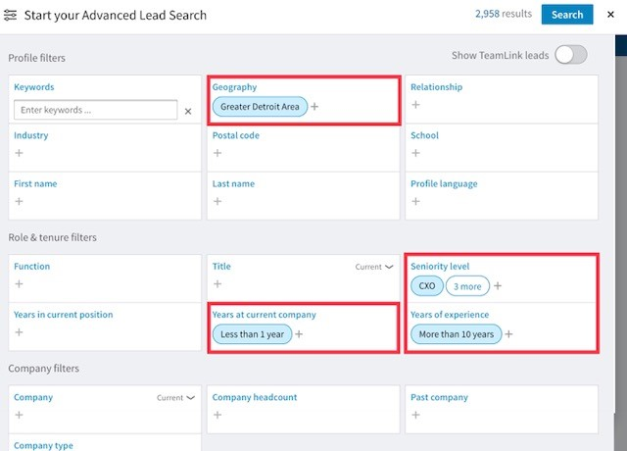
Build a leads list using LinkedIn Sales Navigator
Use Advanced Lead Search to find potential connections who meet specific criteria
Geography
Seniority level
Years of experience
PRO TIP: Advisors who initiated new relationships during the pandemic are more likely to use one of LinkedIn’s premium membership levels, such as Sales Navigator.

Slide 22
Closing thoughts
Notes:
One of the most powerful functions of LinkedIn is its ability for you to prospect for "warm" leads across a variety of criteria.

Slide 23
Closing thoughts
It’s your brand — own it!
Complement your website with a strong LinkedIn profile and company page
Consistency and commitment are keys to developing a loyal following
Use the search tool for research on clients, prospects, and competitors
Notes:
Technology and social media can help you build business, enhance client relationships, and prospect more effectively. Here are some ways to get started:
For ideas you can put to use in your practice right now, visit advisortechtips.com. It is designed specifically for financial advisors, and you’ll find videos, articles, and tips for making the most of technology — in the office, at home, and on the road. Check back often — the blog is updated frequently.
Next, start to make connections on LinkedIn and ask for targeted introductions to people you’d like to meet.
Use the advanced search tools to optimize your networking.
Uncover your clients’ beneficiary designations, and connect with them on LinkedIn. They are the next generation of individuals who will need your expertise.
Making connections may involve some creative thinking — try it and have fun.
“More and more individuals are becoming increasingly comfortable with social media. Typically, the vast majority of our customers have been an older demographic and have not used social media in the past. Over the course of the last couple of years, they have become more comfortable and have used it more.” — Female advisor, age 46

Slide 24
Appendix

Slide 25
Is a Premium account right for you?
Heavy user of LinkedIn for networking and prospecting
Conducting searches daily
Have reached LinkedIn’s search limit
Are consistently prospecting across specific criteria
Have had some measure of success using LinkedIn
Source: Putnam Investments Survey of Financial Advisors’ Use of Social Media Pulse Edition (2020), conducted in partnership with NMG Consulting among U.S.-based financial advisors in May 2021.
Notes:
If you’re still wondering about Premium, consider these items. If you answer yes to two or three, try a Business account for a few months and measure the results.
Is the service worth $50 per month to you? Remember to set goals and benchmarks, such as “generating a prospect list based on my client profile” or “one new prospect every month,” so you can measure the value.
A note on search: LinkedIn allocates a certain (unknown) volume of searches to Free memberships. If you reach this limit, your ability to search will be curtailed until the next month, when your quota resets.

Slide 26
This content is offered for informational purposes only and is not meant as an endorsement of any particular application, mobile device, or social networking site.

