Slide 1
LinkedIn for Students and Young Professionals
Notes:
Thanks for taking the time today to listen to the benefits that LinkedIn can provide to its newest age group. Today, we'll discuss some great tools that can help jump-start a young professional’s career development. These tools can also be used by adults. They can help you find post-bachelor’s degree opportunities, research peers, and discover business connections.
Be sure to always check the LinkedIn blog for exciting news announcements about the site. Social networks are always changing, and being on the forefront can lead to new opportunities. If you have any additional questions about getting the most out of LinkedIn, please contact me or your Putnam internal wholesalers. Using LinkedIn significantly improves my business, and I’m always happy to share tips, tricks, and best practices with you and your peers.
Thanks for your time and have a great day.

Slide 2
The world’s largest professional network
562 million
users across 200 countries
87% of recruiters
use LinkedIn at some point in the hiring process
Over 57 million
companies sharing data
65 million
users in decision-making positions
Source: LinkedIn, 2022.
Notes:
These stats show why professionals need to be on LinkedIn.
If you don't utilize this platform, you could miss out on important opportunities in the future.

Slide 3
LinkedIn provides tools for every step of your professional development
Brand yourself: Optimize your profile and post thoughtful content
Find a college: Research with University pages
Build your network: Connect and engage with students/alumni and join groups
Get a job: Discover opportunities on the jobs page
Notes:
As a young professional just starting out, it's important to start creating your digital footprint. LinkedIn can help you:
Brand yourself online
Find a college
Build your professional network, and
Land your first job
Use the information available to you to research potential colleges and universities, get an internship, and eventually, lock down your first job.

Slide 4
Brand yourself

Slide 5
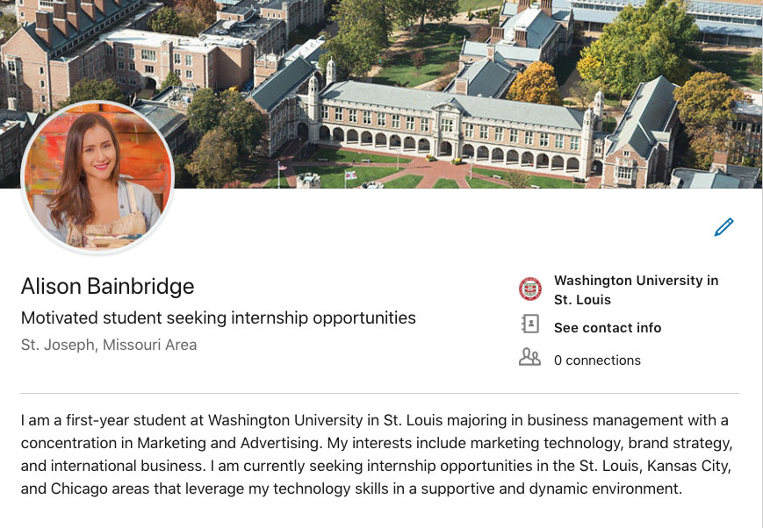
Getting started: Optimize your LinkedIn Profile
PROFILE PICTURE
1
PRO TIP:
Your photo is the most remembered item on your profile.
3
EDUCATION
HEADLINE AND LOCATION
2
SUMMARY
4
CUSTOM URL
5
Notes:
An important first step for making the most of LinkedIn — Optimize your profile.
Doing this correctly can make your profile more attractive to search engines — meaning it will be much easier for people to find you when conducting an online search. You also want to bring your profile in line with professional best practices.
One item to focus on is your profile picture. Pictures speak louder than words. Choose an image that shows you in a professional setting, dressed appropriately. A professional headshot is best. Choose neutral, rather than bright colors. Not recommended: “Selfies” taken with your phone, or pictures in a casual setting.

Slide 6
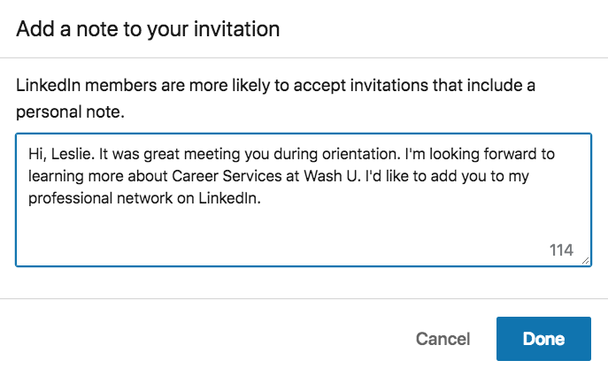
Make quality connections
Connect with people you already know
Classmates
Teachers
Recruiters
Friends and family
Personalize and provide context
PRO TIP:
Make quality connections. The higher the quality of your network, the higher the quality of the opportunities you’ll uncover.
Notes:
Start to build your LinkedIn network by searching for people you already know. Chances are they’re already on LinkedIn.
Build your network around people you know and who will know you when you request to connect.
Specifically, connect with your friends' parents AND your parents' friends. Many people who start at Putnam have leveraged the referral networks of current employees. One of the best places to look for an internship or job is through your parents' network.
The value of your LinkedIn network is only as rich as the connections you make.
Use LinkedIn’s “People you may know” feature to regularly build your network.
Make this a standard part of your LinkedIn practice, and check it at least once a week.

Slide 7
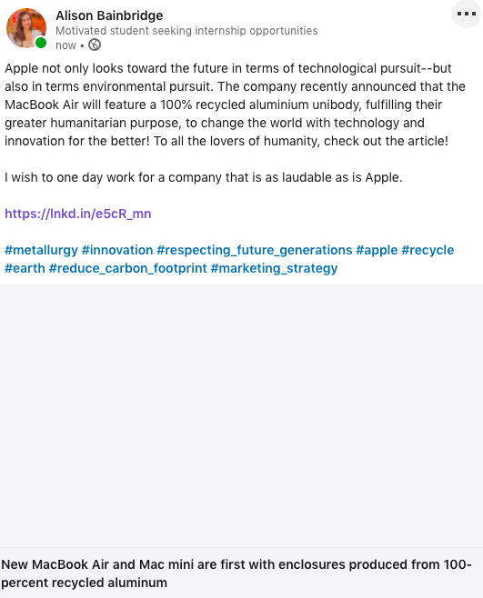
Establish your voice to get noticed
Carefully choose subjects for which you’d like to be known
Start regularly sharing interesting content related to these topics
Ask for profile recommendations and endorsements from mentors
Notes:
Start to build your LinkedIn network by searching for people you already know. Chances are they’re already on LinkedIn.
Build your network around people you know and who will know you when you request to connect.
The value of your LinkedIn network is only as rich as the connections you make.
Use LinkedIn’s “People you may know” feature to regularly build your network.
Make this a standard part of your LinkedIn practice, and check it at least once a week.

Slide 8
Finding a college

Slide 9
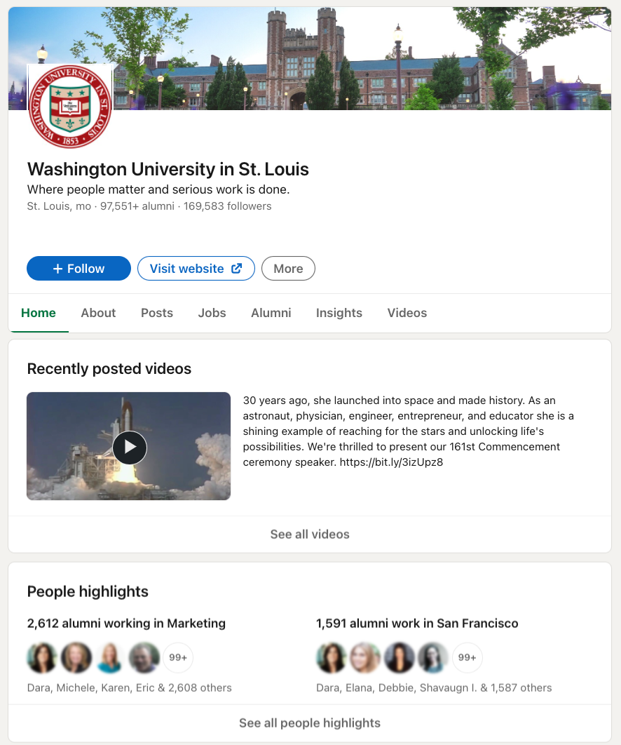
Gather information from University Pages
Discover popular career paths and fields of study
Quickly gather important statistics
ALUMNI
PRO TIP:
Connect with your parents and close family friends. Their networks can provide valuable alumni referrals.
RESEARCH CAREER PATHS
Notes:
Use University Pages to get a feel for where each university can take you. On these pages, you can see high-level statistics like how many alumni are on LinkedIn, as well as dive deeper into potential career paths with the “Career Insights” tool.

Slide 10
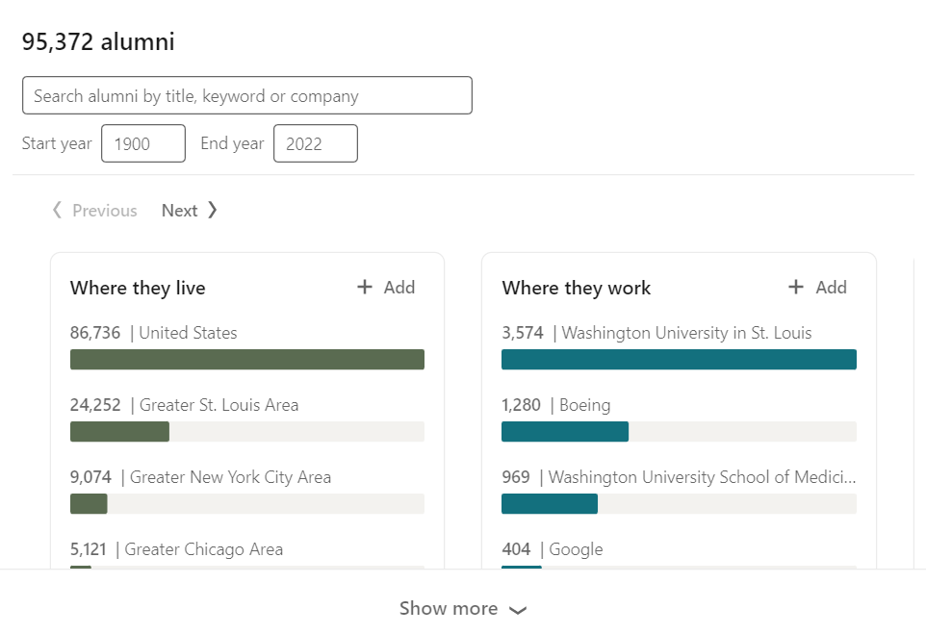
Utilize the Career Insights tool
Search alumni to see which universities’ alumni achievements align with your career goals
Connect with students and alumni who can open doors to educational and professional success
NARROW SEARCH BY TITLE, KEYWORD, OR COMPANY
FILTER BY UNIVERSITY AND DATES ATTENDED
GROW YOUR NETWORK BY CONNECTING WITH ALUMNI AND STUDENTS
Notes:
The Career Insights tool lets you filter alumni data from each university you select. You can search through alumni by the year they graduated, you can narrow your results by searching for a title, keyword, or company, and you can identify the best alumni to connect with to help you accomplish your career goals.
This section is meant to help you determine how to break into your field of choice and suggest people to connect with that can help you on your journey.

Slide 11
Finding and landing an internship or first job

Slide 12
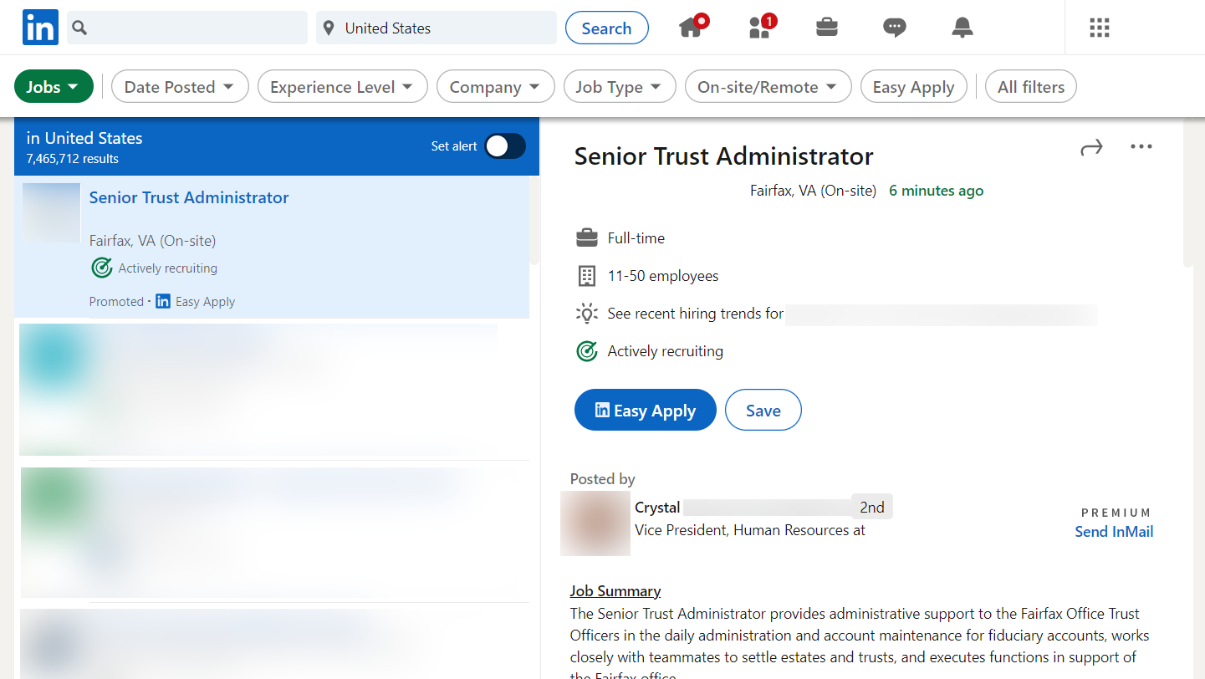
Search jobs
FILTERS LET YOU SEARCH BY DATE, COMPANY, AND EXPERIENCE
Click the briefcase icon on the top toolbar
Quickly search for entry-level jobs and internships
NARROW YOUR SEARCH TO GET THE BEST RESULTS
Notes:
The job search feature lets you focus results with a few important filters:
Date posted: Brings up the newest posts first
LinkedIn features: Lets you search for jobs connected to people in your network, pulls in jobs that have under 10 applicants, and lets you narrow your results to only jobs that accept "LinkedIn easy apply"
The other filters are pretty self explanatory, but the key is to use these tools to find the jobs that are most relevant to your experience and career goals.

Slide 13
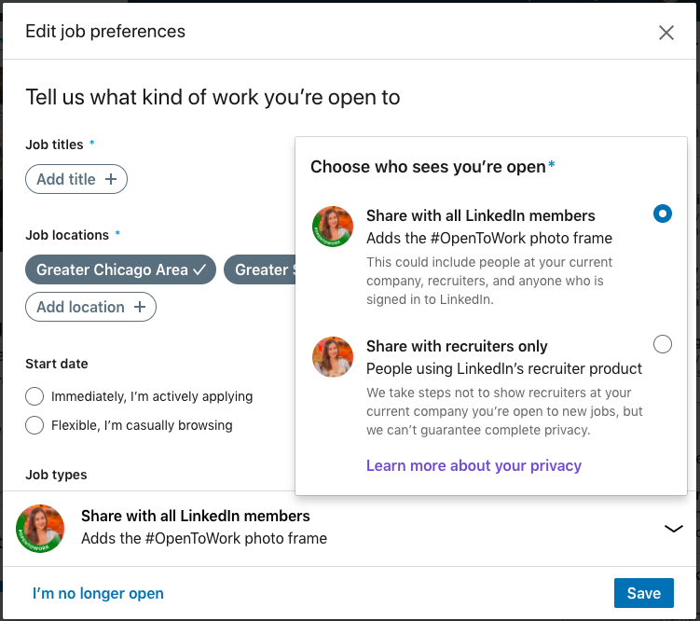
Edit job preferences
ACTIVATE EITHER FEATURE SO RECRUITERS KNOW THEY CAN MESSAGE YOU ABOUT RELEVANT OPPORTUNITIES
Let recruiters know if you’re open to new opportunities
Select the titles of jobs you’re interested in
Define a location
Choose some industries
Determine the right company size
Notes:
If you're looking for a new job or internship, be sure to turn on the "Let recruiters know you're open" to new opportunities button. This lets them know it's OK to message you about open positions.
When you flip this switch, it's important to also fill out your career interests so recruiters can reach out with the most relevant positions. You can tell them:
Where you are in your search
When you can start
Which titles are most appealing to you
Which locations you're considering
What type of job fits you best (full/part-time, internship)
Which industries you're focusing on
What size company fits you best
The more complete this section is, the more relevant your discussions (and the positions) will be.

Slide 14
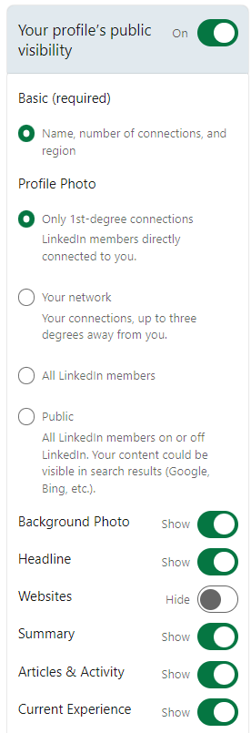
LinkedIn Terms of Service
The minimum age to use LinkedIn is 16
LinkedIn offers no additional protections for minors beyond the general Terms of Service
You control your profile’s appearance for viewers who are not logged-in members. Limits you set here affect how your profile appears on search engines, profile badges, and permitted services like Outlook.
RECOMMENDATION:
Those under the age of 18 should adjust their privacy settings to keep their information visible only to 1st level connections.
Source: LinkedIn.
Notes:
It's important to note that the minimum age to use LinkedIn is 16, and LinkedIn does not provide additional protections for minors beyond their general Terms of Service.
However, you do have the ability to apply settings to your profile that control what people can see about you when they're not logged into LinkedIn. These settings can help you control what information appears in search engines.

Slide 15
Closing thoughts: Getting started
Optimize your LinkedIn profile
Start to make valuable connections
Ask for targeted recommendations and endorsements
Use the search tool for research on universities, companies and jobs
Switch your profile to “open to” if you’re actively searching for jobs
Continually enhance your social brand
Notes:
Next, start to make connections on LinkedIn and ask for targeted introductions to people you’d like to meet.
Use the advanced search tools to optimize your networking.
Uncover your clients’ beneficiary designations, and connect with them on LinkedIn. They are the next generation of individuals who will need your expertise.
Making connections may involve some creative thinking — try it and have fun.

Slide 17
This content is offered for informational purposes only and is not meant as an endorsement of any particular application, mobile device, or social networking site.

