Slide 1
Preventing identity theft and cybercrime
Notes:
The two parts to this presentation will focus on very significant issues facing all of us today.
Note to presenter: The entire presentation should take 30 minutes. It should breakdown like this:
Intro and part 1: 10 minutes
Part 2: 15 minutes
Questions: 5 minutes
You should tell the audience to please hold questions until the end, otherwise you might get bogged down and not make it through the materials in the planned time.

Slide 2
About the presenter
Putnam Investments is not affiliated with Jeff Lanza.
Notes:
A little bit about myself.

Slide 3
Part 1 Three tips to help prevent identity theft
Notes:
Here are three tips to help prevent identity theft.

Slide 4
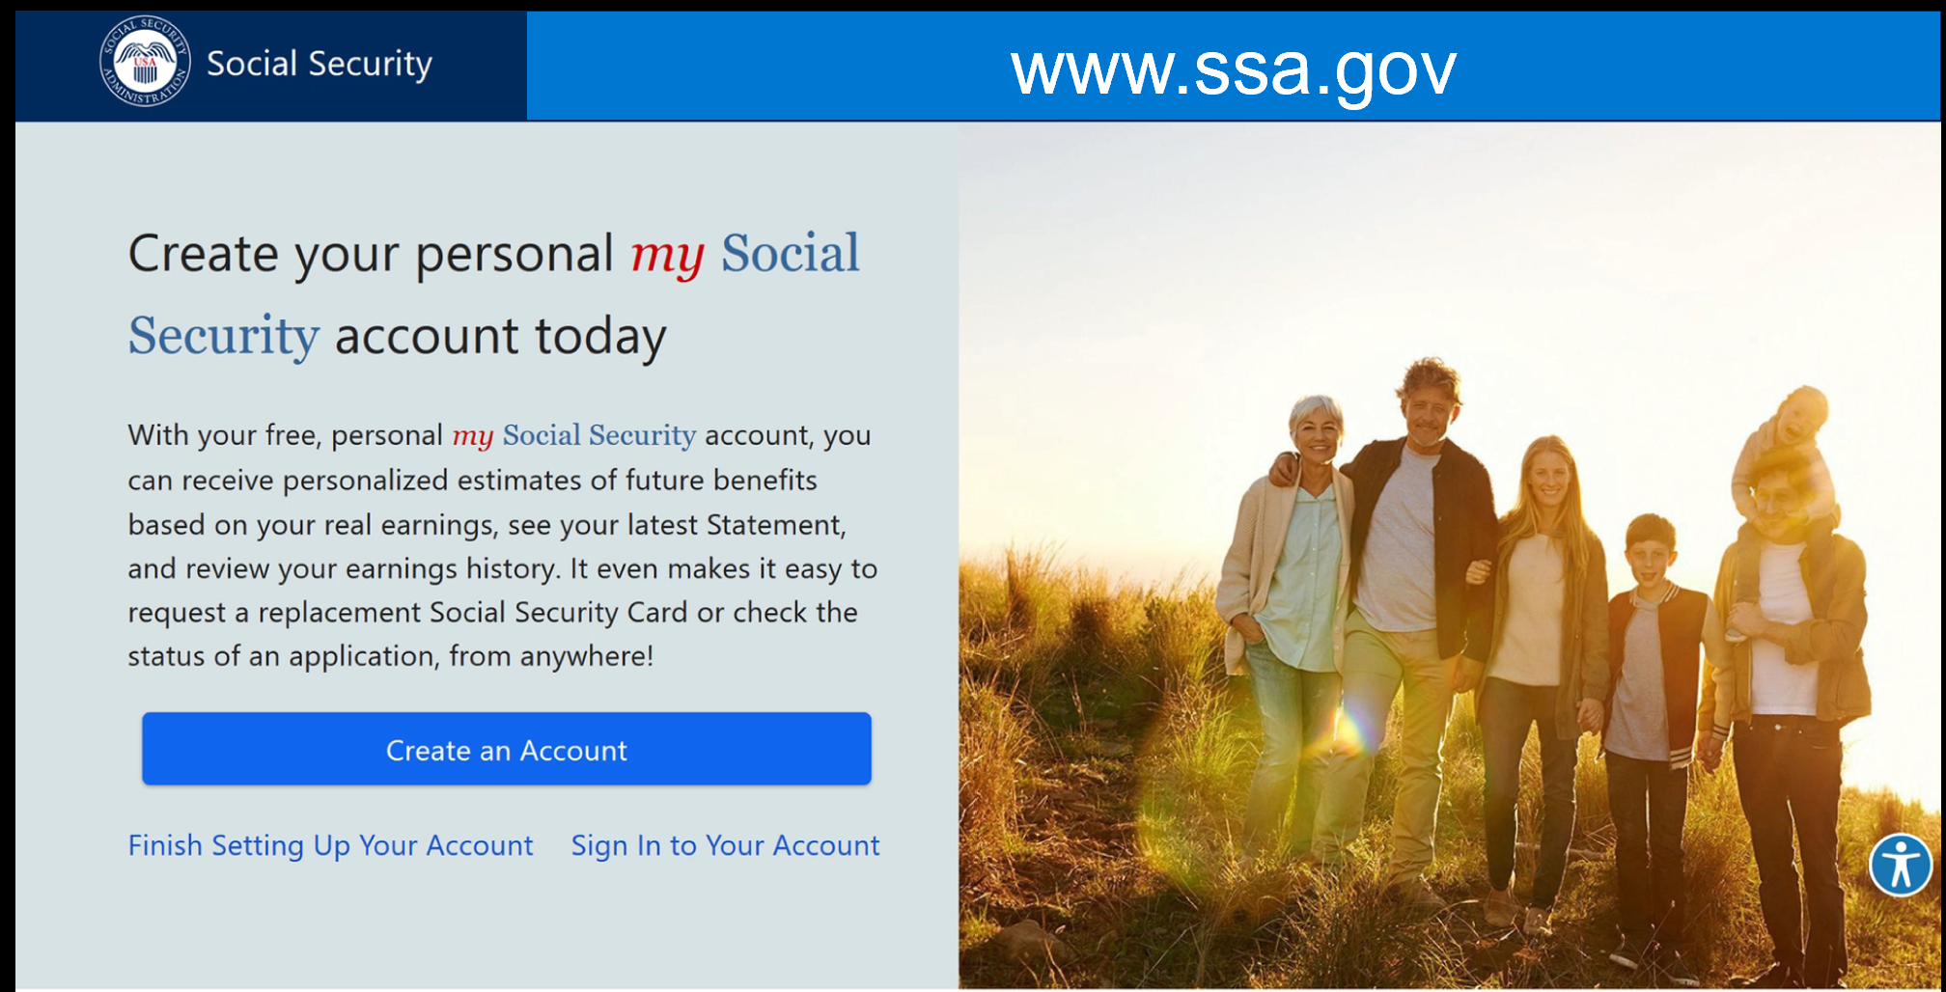
1
TIP
Create on online Social Security account
Notes:
Have you done this? Go to ssa.gov and create a “my Social Security” account. It doesn't mean you have to collect benefits, it just means you have a username and password set up so a criminal can't do that in your place and have your benefits directed to their bank account. This is especially important if you are eligible to collect benefits, but you can set it up at any age.

Slide 5
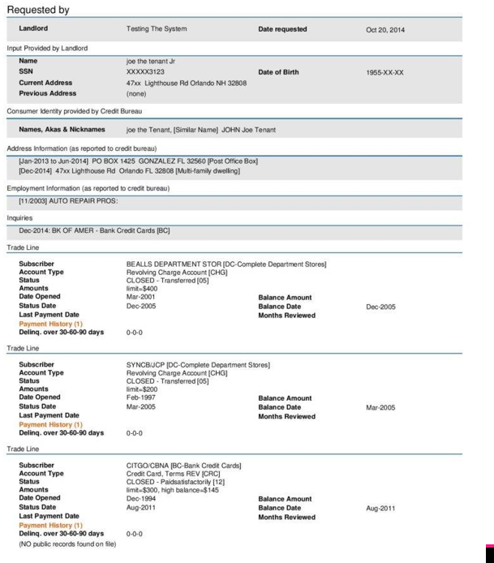
2
TIP
Freeze your credit reports
Credit Report
Equifax
Transunion
Experian
Innovis
Frozen
Freezing does not affect your current credit cards.
You must freeze all four credit reports independently.
Notes:
Freezing credit reports is the best way to stay safe from many types of what's called new account fraud — that being criminals opening up credit card and other financial accounts in your name. If a person has your Social Security number and some other identifying information, they might be able to do this. But that can’t do it if you credit reports are frozen, because the creditor will not open the account unless they can check the credit report of the person whose identity is being used.

Slide 6
2
There are four credit reporting agencies
It is easiest to freeze your credit reports at the websites of each agency:
Experian
(888) 397-3742 | P.O. Box 9530 Allen, TX 75013 www.experian.com/freeze
Equifax
(800) 685-1111 | P.O. Box 740241 Atlanta, GA 30374 www.equifax.com/personal/credit-report-services
Innovis
(800) 540-2505 | P.O. Box 1640 Pittsburgh, PA 15230 www.innovis.com/personal/securityfreeze
Trans Union
(888) 909-8872 | P.O. Box 2000 Chester, PA 19016
www.transunion.com/credit-freeze
Notes:
Most people have not heard of a smaller credit reporting agency called Innovis. It is recommended that your freeze that one, along with the others. It is easiest to freeze your credit reports at the websites of each agency. You can lift the freezes at the same sites if you need to get your credit checked for a legitimate reason. Then you can freeze it again. There is no cost to freeze or lift freezes.

Slide 7
3
Create an IRS Identity Protection PIN
https://www.irs.gov/identity-theft-fraud-scams/get-an-identity-protection-pin
An Identity Protection PIN (IP PIN) is a six-digit number that prevents someone else from filing a tax return using your Social Security number or Individual Taxpayer Identification Number. The IP PIN is known only to you and the IRS. It helps the IRS verify your identity when you file your electronic or paper tax return. Even though you may not have a filing requirement, an IP PIN still protects your account.
If you want to request an IP PIN, please note:
You must pass a rigorous identity verification process
Spouses and dependents are eligible for an IP PIN if they can pass the identity verification process
How to get an IP PIN
The fastest way to receive an IP PIN is by using the online Get an IP PIN tool. If you wish to get an IP PIN and you don’t already have an account on IRS.gov, you must register to validate your identity. The IP PIN tool is generally available starting in mid-January through mid-November.
Notes:
If a criminal had your Social Security number, they can file a tax return using your identity. It works like this: With your information, the criminal files a tax return using your identity; the IRS provides the refunded amount to the criminal. When you file your tax return, it gets rejected.
To prevent this from happening you can create an IRS Identity Protection PIN (IP PIN). This is a picture of the website that provides more information about creating an IP PIN. You can apply for an IP PIN on this site. The IRS will mail you the number in a secure envelope, and you will need that number to file your taxes. They will send you a new number every year.

Slide 8
Part 2 Five tips to help prevent cybercrime
Notes:
Here are five tips to help prevent cybercrime.

Slide 9
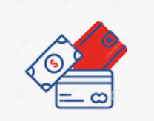
1
Beware of phishing
From: custom service@yourcreditcard.com
To: me
Hello,
There is a problem with your account. You are required to use this form to update your login information immeadiatelly.
Thank you for your assistance,
Your service team.
Acme Credit Cards
Generic greeting
Misspelling or grammar errors
Links to fake login sites
Click here now
Unsolicited attachments
Notes:
From the FTC:
Phishing is a type of online scam that targets consumers by sending them an e-mail that appears to be from a well-known source — an internet service provider, a bank, or a mortgage company, for example. It asks the consumer to provide personal identifying information. They may try to steal your passwords, account numbers, or Social Security numbers. If they get that information, they could gain access to your email, bank, or other accounts. Scammers launch thousands of phishing attacks like these every day — and they’re often successful.
Here are four signs of a phishing email:
If you receive a phishing email, you can forward it to the company through the security page on their website.
Don’t reply or click on links or attachments. If you click on an attachment, it could put download malware to your computer, which brings me to my next point …

Slide 10
2
Keep your products free of malware
From: custom service@yourcreditcard.com
To: me
Hello,
There is a problem with your account. You are required to use this form to update your login information immeadiatelly.
Thank you for your assistance,
Your service team.
Acme Credit Cards
Click here now
Unsolicited attachments
Notes:
Let’s take a look at that same phishing email, only this time we will focus on the attachment. One of the most common ways that malware is downloaded to a person’s computer is by clicking on an attachment in an email. Just looking at the email should not cause a problem, but clicking on the attachment will. You should never click on attachments in emails from unknown senders or suspicious senders like this.

Slide 11
2
Keep your products free of malware
Malicious software
Don’t download something that you were not expecting
Use anti-virus software
Keep your computer and browser updated
Unsolicited attachments
Notes:
The word malware is derived from two terms, malicious and software. So again, we should not click on the attachment in the email like this, or more generally, an attachment in an email you were not expecting.
In addition, we have two more lines of defense:
Your anti-virus software provides perimeter security and will block some malware from downloading to your computer even if you do click in the wrong place. But hackers are often creating new malware that anti-virus software doesn’t recognize as a threat. So, we still need to be careful.
Your browser, such as Google Chrome, Mozilla Firefox, and Microsoft Edge also provides a layer of security. If they recognize a threat, they may warn you not to continue. However, the browsers can only warn you about things they know about, so it is also important to keep your browser updated. If an update is available, it generally tells you that when you open a new browser session.

Slide 12
3
Use strong passwords or passphrases
Most common passwords in 2022
123456
123456789
qwerty
password
12345
qwerty123
1q2w3e
12345678
111111
1234567890
A strong password is at least eight characters long with complexity
A strong passphrase is at least a twelve-character string
Use a unique password or phrase for every account
Use a password manager to help keep track of your different passwords or phrases
Notes:
It is important to use strong passwords to protect all of your online accounts.
Every year, we learn about the most common passwords that people use to protect their accounts. Here are the top ten. As you can see, these accounts would not be very secure from hackers, not only because most of the passwords are weak, but because criminals know about this list.
Use a strong password that is a minimum of 8 characters long with an upper case, lower case, number and symbol.
If the site accepts a passphrase, no complexity is needed, but the string should be at least 12 characters long.
It is important that you use a unique password/passphrase for each account. This prevents hackers from getting a password from one breach and using it to breach other accounts.
You might consider using a password manager. They are considered to be a reliable and secure way to store passwords.
Using a browser to store passwords has risks — if someone got physical access to your computer or infected it with malware, it is possible they could log in to the sites with saved passwords.

Slide 13
3
Passphrase
Username
bankcustomer533
Password
1Pennysavedisapennyearned$
Notes:
Here is an example of a passphrase that also contains complexity — some sites still require that. The advantage to passphrases is that they are easy to come up with and easier to remember, although you still need a password manager if you have multiple online accounts, as most people do.

Slide 14
4
Use two-factor authentication
Implement it for financial accounts and email account at a minimum
Provides an extra layer of security
Easy to set up and use
Two-factor authentication
Notes:
Two-factor authentication is a great tool to increase the security of online accounts. It should be used for financial accounts and email accounts at a minimum.
As long as you have your phone handy, you can log in by using the extra code that is sent by the website to your mobile device.

Slide 15
5
Protect your mobile devices
Use a passcode to protect your mobile device
Only download apps from the official app stores
Keep your device updated
Back up your device
Notes:
Mobile devices are considered to be very secure. Users have a role in security. Always use a passcode to protect the contents of the device and the apps.
Speaking of apps, only download apps from the Apple Store or Google Store (for Android devices).
To stay safe against security threats, it is important to keep the device software updated, especially when an update is flagged as fixing a security issue.
Just in case there is a problem with your phone or it is lost or stolen, it is a good idea to have the contents of the device backed up to the cloud.

Slide 16
Questions
Notes:
You should leave about 5 minutes for questions.

